Slide 1
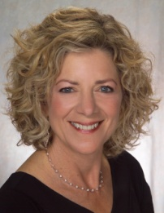
WOMEN OF REFORM JUDAISM
Artifact Webinar
Please Note: This webinar is being recorded.
Both the link to this recording and the PowerPoint presentation
will be sent to you following this webinar.

Slide 2
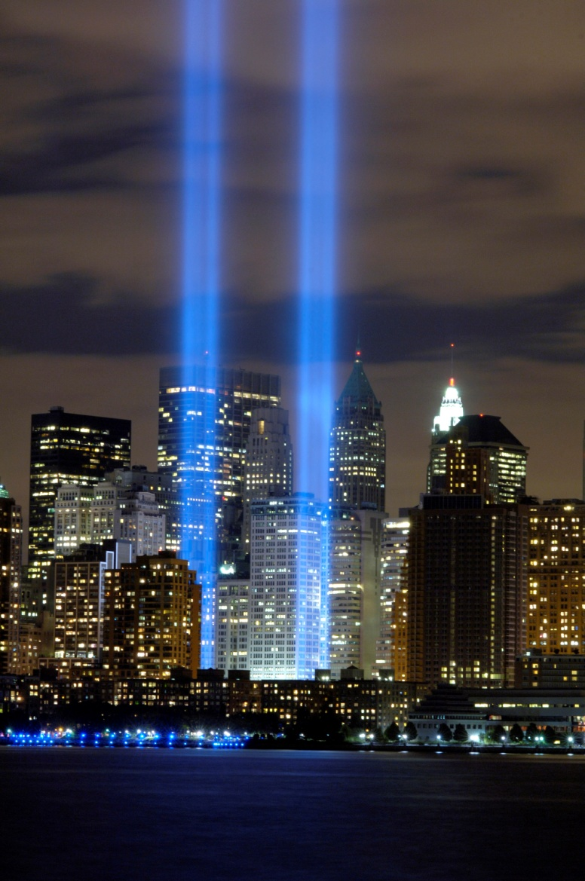
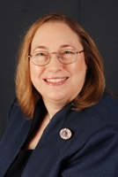
In Remembrance

Slide 3
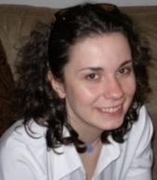
Webinar Attendee Helpful Tips
Lets review a few guidelines for optimal Webinar attendee experience.
This webinar broadcast has begun with all attendees in “Listen Only” mode.
On the next couple of slides, we’ll explain how to use your “Webinar Control Panel.”

Slide 4
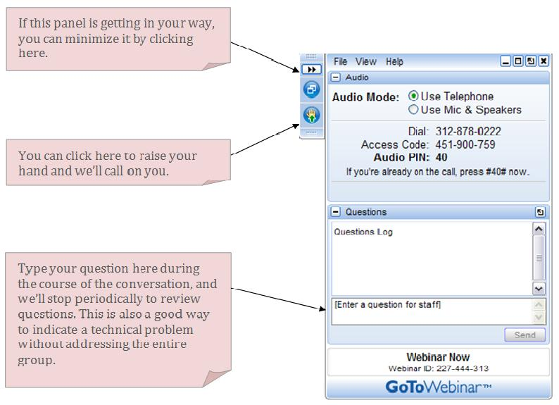
Helpful Tips: General Use

Slide 5
Helpful Tips: Audio Controls
You have the option of choosing one of two audio modes:
Telephone
Mic & Speakers
When using the telephone component be sure to enter your audio pin, which is displayed in the audio pane.

Slide 6
Helpful Tips: Help Options
If you are encountering any issues with your webinar experience, please type your questions into the Questions Log.
Thank you for your attention and patience! Now let’s begin our presentation.

Slide 7
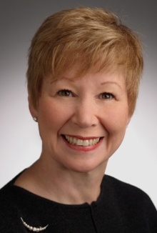
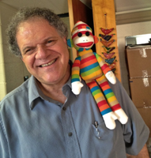
WOMEN OF REFORM JUDAISM
Artifact Webinar
Presented by Rabbi Samuel K. Joseph, Ph.D.
Eleanor Sinsheimer Distinguished Service Professor
of Jewish Education and Leadership Development
Hebrew Union College-Jewish Institute of Religion

Slide 8
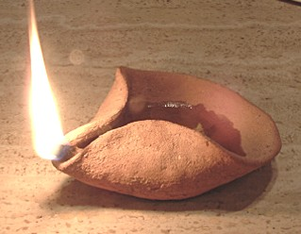
What are artifacts?
Artifacts are things that are formed by humans…
and so are of interest today.

Slide 9
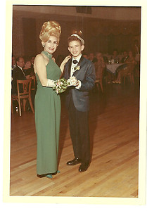
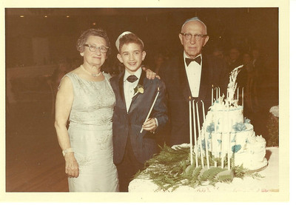

Slide 10
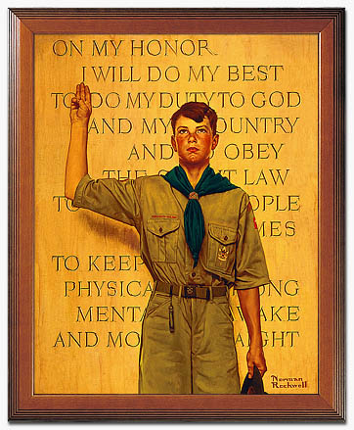
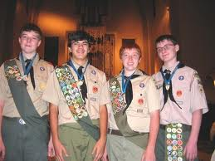

Slide 11
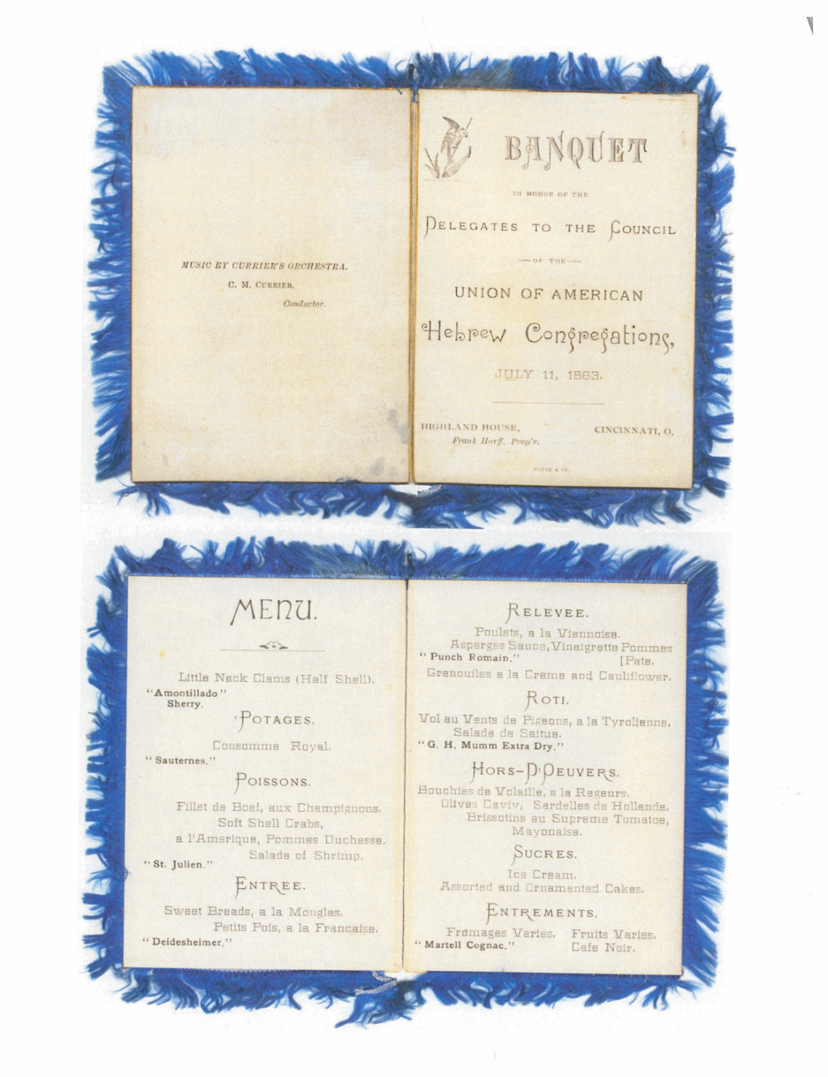

Slide 12
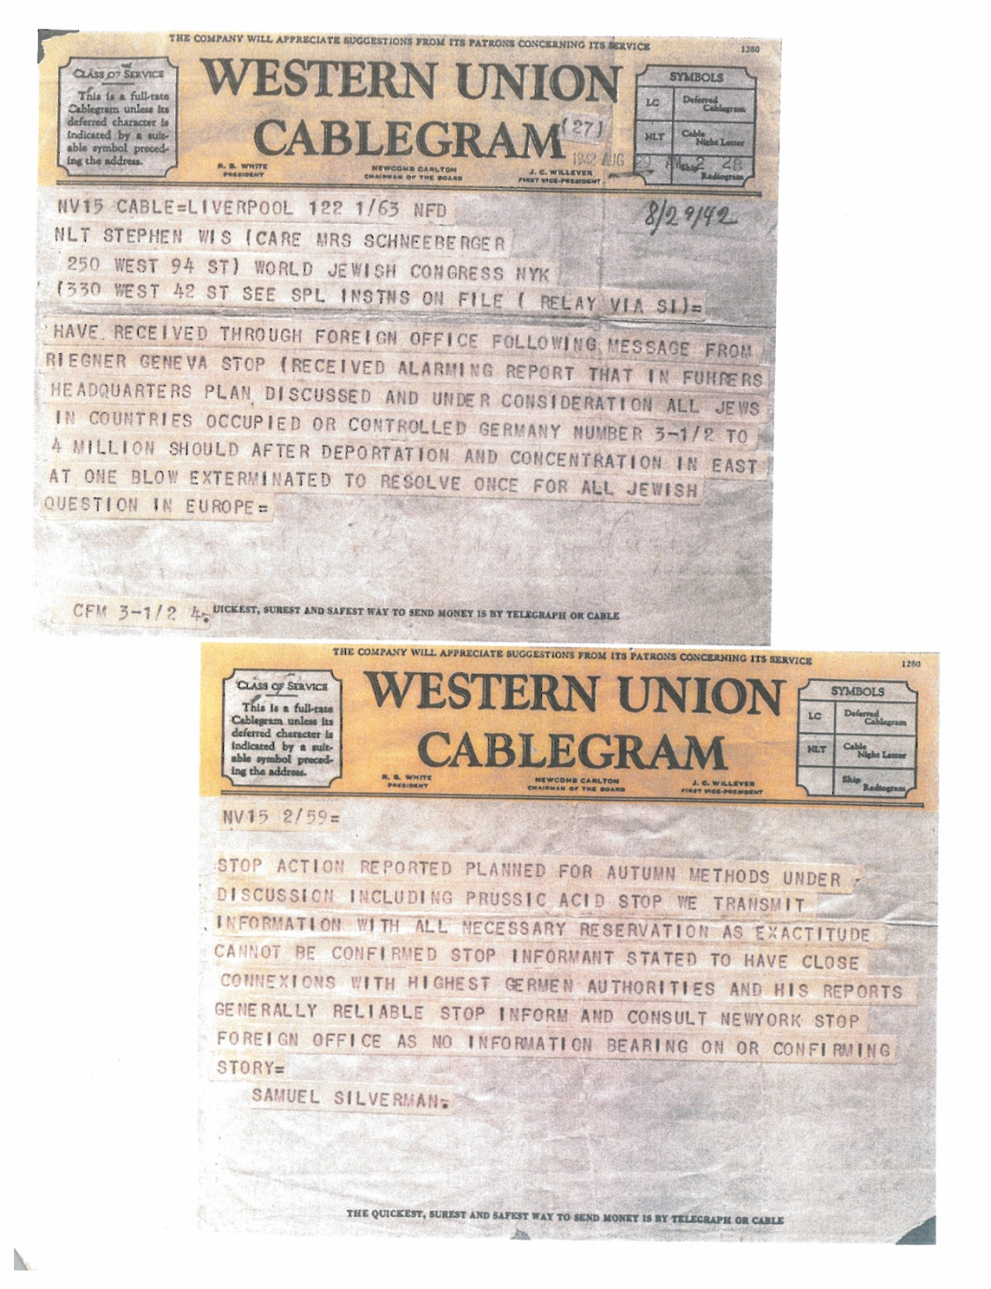

Slide 13
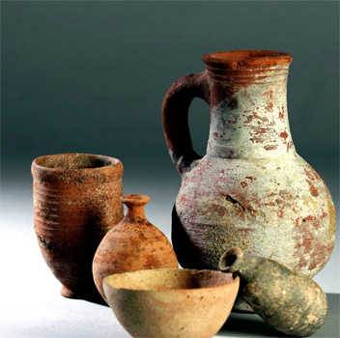
Archeological Artifact
Something made or given shape by humans, such as a tool or a work of art, especially an object of archaeological interest
Recovered by archaeological endeavor
Examples include:
Stone tools
Metal objects
Items of personal adornment
Bone that shows human modification
Fire cracked rocks from a hearth
Plant material used for food
Notes:
An artifact or artifact (from Latin phrase arte factum, from ars skill + facere to make) is "something made or given shape by man, such as a tool or a work of art, esp an object of archaeological interest". "Artifact" is the usual spelling in the US and Canada, "Artifact" in the UK, Europe and Australasia (see spelling differences).
In archaeology, where the term is most commonly used, an artifact is an object recovered by some archaeological endeavor, which may have a cultural interest.
Examples include stone tools such as pottery vessels, metal objects such as guns, and items of personal adornment such as buttons, jewelry and clothing. Other examples include bone that show signs of human modification, fire cracked rocks from a hearth or plant material used for food

Slide 14
Cultural Artifact
A term used in social sciences for anything created by humans which gives information about culture of creator and users
Encompasses artifacts recovered at archaeological sites
Current objects of modern or near-modern society
Examples include:
17 century lathe
Piece of faience
A television
Notes:
Cultural artifact is a term used in the social sciences, particularly anthropology, ethnology, and sociology for anything created by humans which gives information about the culture of its creator
and users. Usage of this term encompasses the type of archaeological artifact which is recovered at archaeological sites; however, current objects of modern or near-modern society are also cultural artifacts. For example, in
an anthropological context, a 17th-century lathe, a piece of faience, or a television each provide a wealth of information about the time in which they were manufactured and used. Cultural artifacts can provide knowledge
about technological processes, economy and social makeup, and a host of other subjects.

Slide 15
Social Artifact
Any product of individuals or groups or of their social behavior
Objects or products designed and used by people to meet reoccurring needs or solve problems
Example – A document
Several types of artifacts:
Primary artifacts (digital camera, corkscrew)
Secondary artifacts (manual to use digital camera)
Does not have to have physical form; Does not have to have historical value

Slide 16
Definition of Culture
A culture is a pattern of basic assumptions invented, discovered, or developed by a
given group as it learns to cope with problems…that has worked well enough to be
considered valid and, therefore, to be taught to new members as the correct way to
perceive, think and feel in relation to those problems. (Edgar Schein 1985)

Slide 17
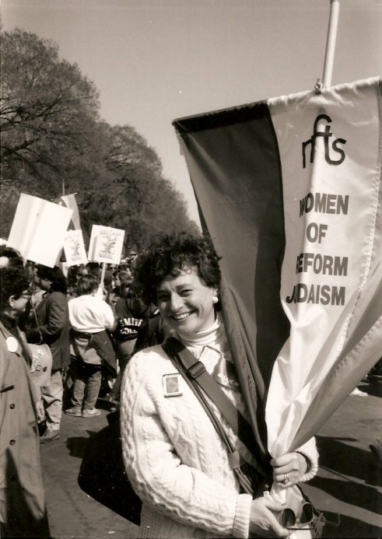
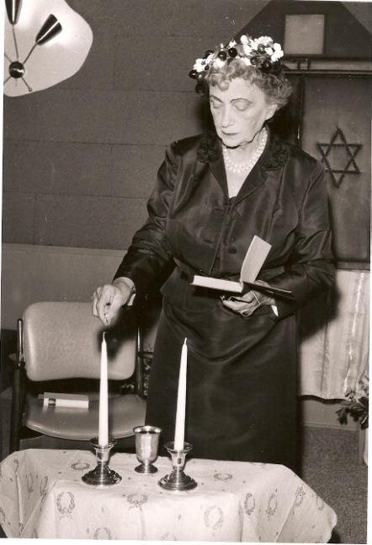
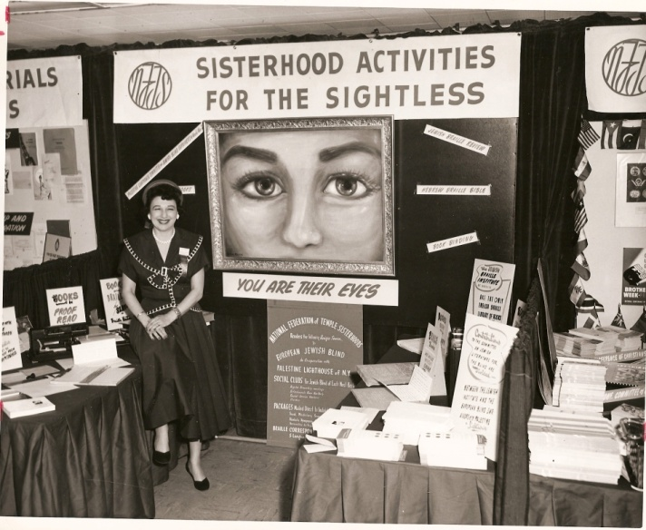
WRJ Artifacts

Slide 18
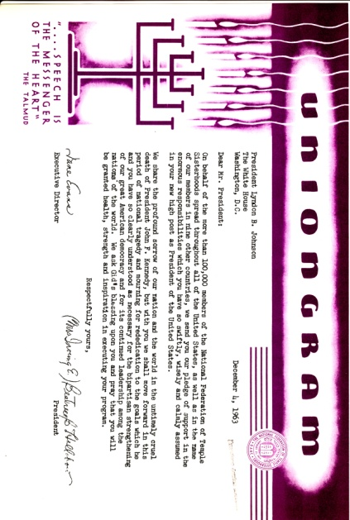
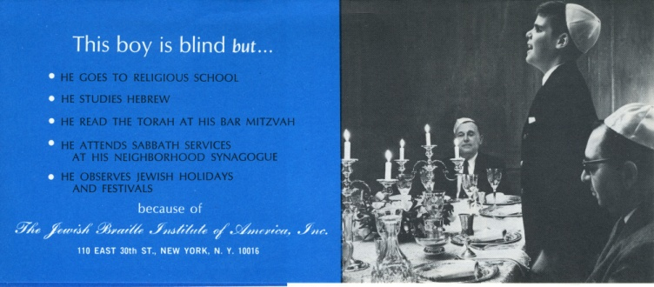
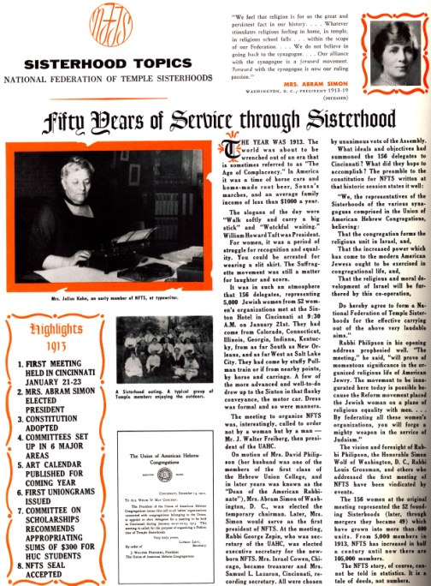
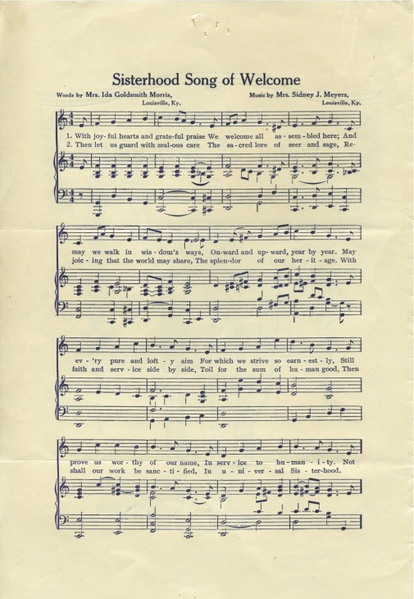
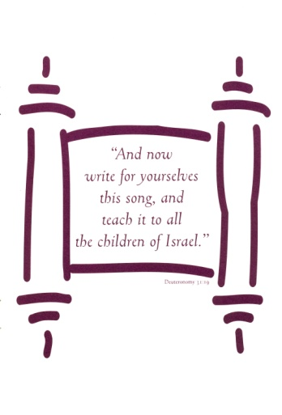
WRJ Artifacts

Slide 19
First Things First
Select sisterhood artifacts (documents, records, photos, small items)
Complete and send submission form to AJA
Three ways to send form:
E-mail: kproffitt@huc.edu
Fax: 513-221-7812
Mail: American Jewish Archives WRJ Project 3101 Clifton Avenue Cincinnati, OH 45220
Archivist from AJA will contact you; select items and provide shipping details
Ship items to AJA with copy of submission form
For consideration in January exhibition,
you must complete process by December 15, 2012

Slide 20
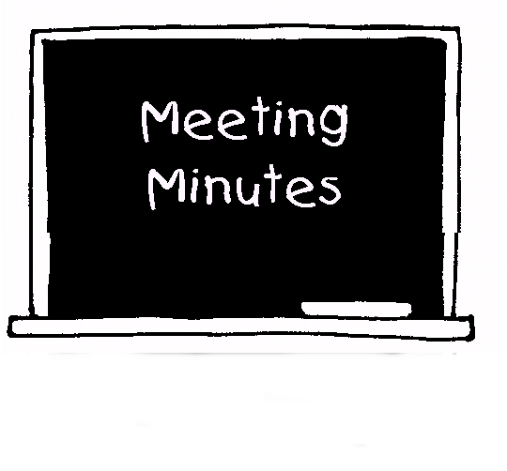
Acceptable Items
Records relating to establishment of sisterhood
Subject files of officers and administrators
Membership records
Annual or committee reports
Selected project files
Publications, programs, and PR materials
Photographs and media

Slide 21
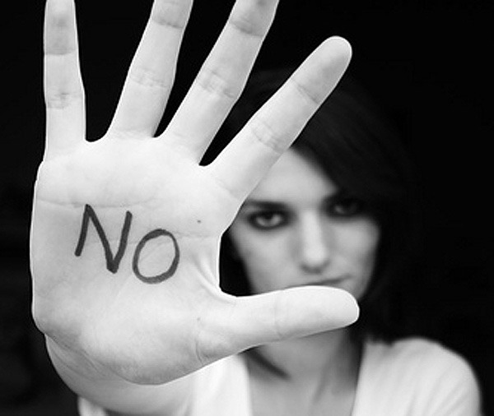
Items that will NOT be considered
Large artifacts
Business records
Day-to-day records that are NOT historically valuable

Slide 22
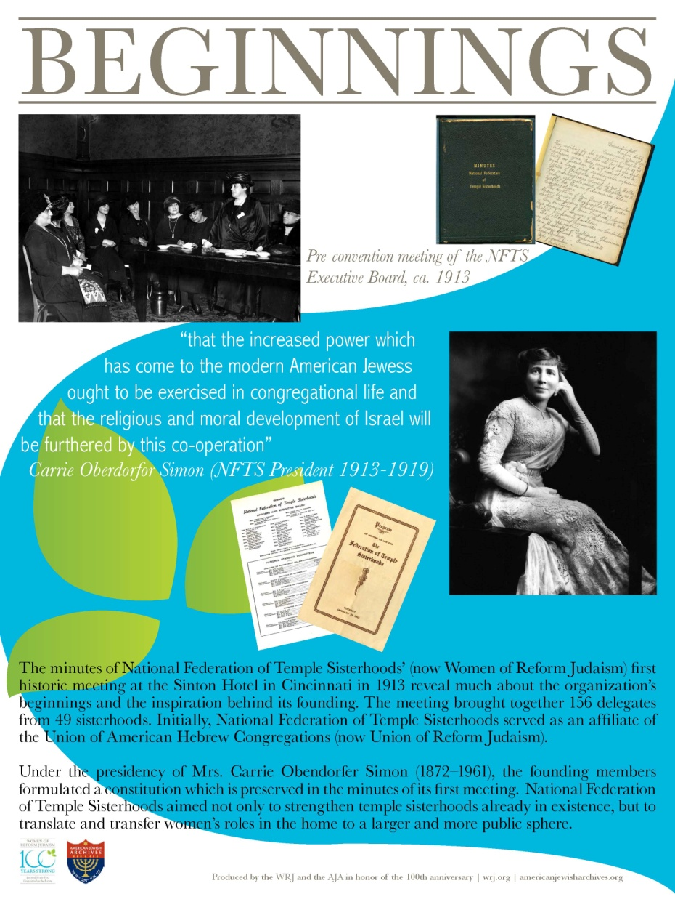
Local Sisterhood Exhibits

Slide 23
Have a Question?
If you have questions about this project, contact:
Rachel Jurisz
Manager, Service to Sisterhoods and Districts
rjurisz@wrj.org or 212.650.4063

Slide 24
Questions & Answers
If you would like to type a question, please use the Questions panel.
We may not have the availability to answer every question. Fear not! We will follow-up with you after the presentation should we not answer your question during our webinar.

Slide 25
Upcoming Centennial Programs
Building a Movement
Unsung Heroines
Fried Leadership Conference, Cincinnati January 25-27, 2013
Centennial Shabbat March 1-2, 2013
Mission to Israel and Berlin March 5-17, 2013

Slide 26
Thank you for attending!
If you have any further questions, please contact:
Lynn Magid Lazar Rosanne Selfon
President Chair, WRJ Centennial
Women of Reform Judaism WRJ Immediate Past President
lynn.magid.lazar@gmail.com rosanne.selfon@gmail.com
412.967.0811 7 717.285.3910
Rabbi Marla J. Feldman Rachel Jurisz
Executive Director Manager
Women of Reform Judaism Service to Sisterhoods and Districts
mfeldman@wrj.org rjurisz@wrj.org
212.650.4055 212.650.4063
A recording of this webinar presentation will available on the WRJ website: www.WRJ.org

